Slide 1

Active inference as a computational framework for modeling empirical data
Ryan Smith
Email: rsmith@laureateinstitute.org
Twitter: @RyanSmith_LIBR

Slide 2
Outline
Part 1 (Smith):
Recap of active inference models
Address residual questions
Practical coding example of building a behavioral task model with reward probability learning
And fitting that model to data
Part 2 (Hodson):
Practical example of building a state exploration task
Walkthrough code for inferring states and actions
Practical coding example of building a hierarchical model of a perception task
Walkthrough code for simulating neural responses in the model
Part 3 (Hakimi):
More detailed discussion of mathematical underpinnings
Q&A

Slide 3

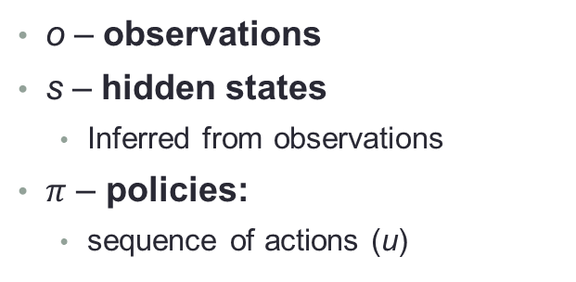
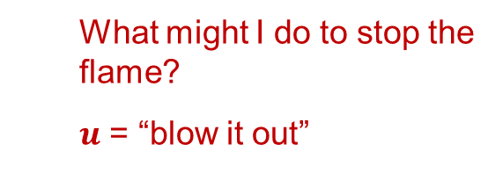
o – observations
s – hidden states
Inferred from observations
$π$ – policies:
sequence of actions (u)
What might I do to stop the flame?
$u$ = “blow it out”

Slide 4
Generative process – actual objects/events generating observations
Generative model – beliefs about the generative process and how it will be affected by action
Assigns a probability to each possible combination of observations, states, and policies

Slide 5
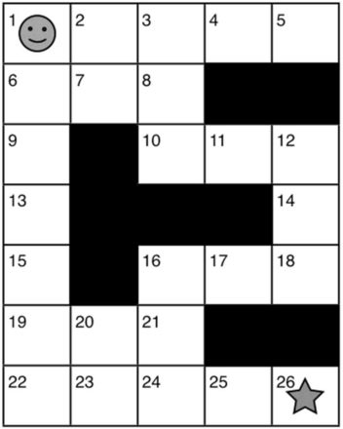
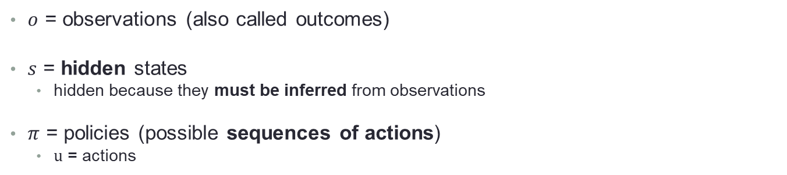
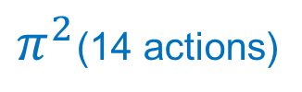
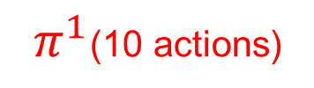
Terms and notation
$π^{2}$(14 actions)
$π^{1}$(10 actions)
Start
$o$ = observations (also called outcomes)
$s$ = hidden states
hidden because they must be inferred from observations
$π$ = policies (possible sequences of actions)
$u$ = actions
All other states = -1
Goal
(+10)

Slide 6
Active inference formalism

Slide 7
What is it good for?
Motivated by biological plausibility
Clear ways in which neural networks can implement all the linked equations in the model
It has an accompanying neural process theory
Provides the opportunity to generate and test precise hypotheses in neuroimaging studies
EEG - event-related potentials (ERPs)
fMRI - localized neural responses

Slide 8
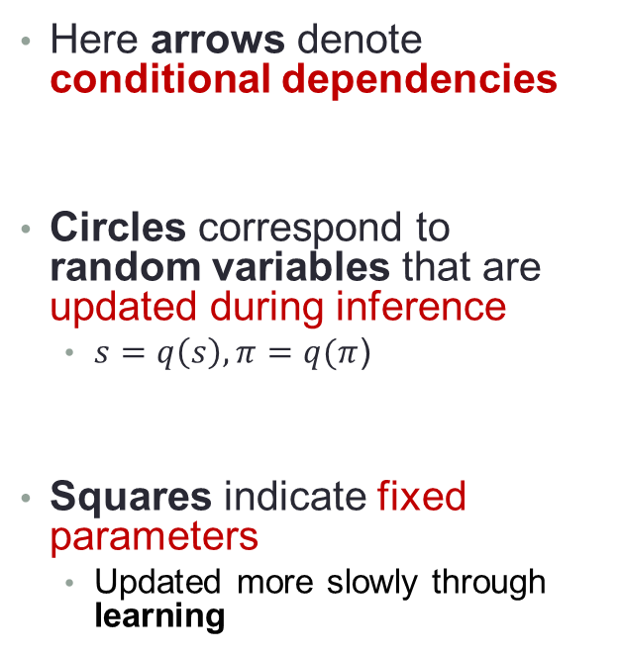
Graphical model depiction of active inference
Here arrows denote conditional dependencies
Circles correspond to random variables that are updated during inference
$s=q\left(s\right),π=q(π$)
Squares indicate fixed parameters
Updated more slowly through learning

Slide 9
Graphical model depiction of active inference
Action Selection
Perception

Slide 10
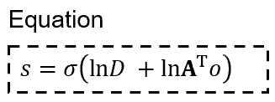
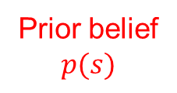
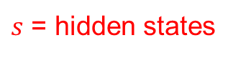
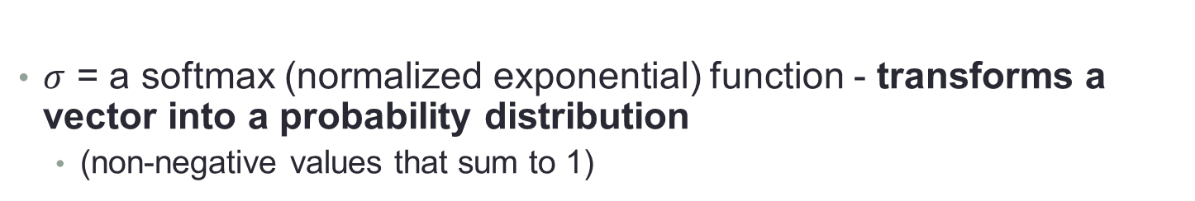
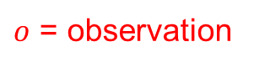
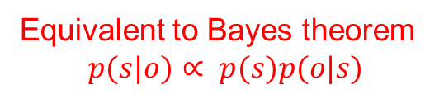
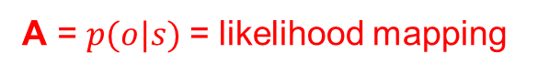
Static perception
Equivalent to Bayes theorem
$$p(s|o)∝ p(s)p(o|s)$$
$s$ = hidden states
Prior belief
$$p(s)$$
A = $p(o|s)$= likelihood mapping
$o$ = observation
$σ$ = a softmax (normalized exponential) function - transforms a vector into a probability distribution
(non-negative values that sum to 1)

Slide 11
Example

Slide 12
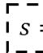
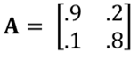
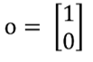
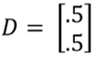
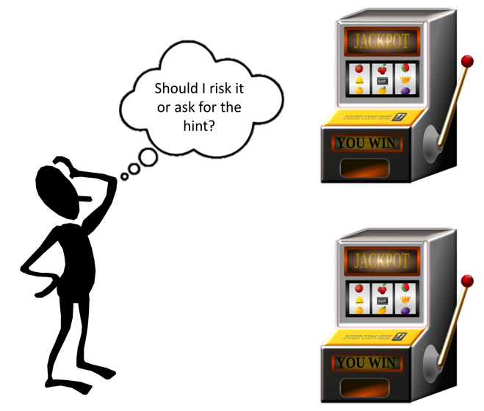
Static perception
?
Left machine is more likely to pay out
L R
p(hint=left machine | left machine is better) = .9
Hint = “try left machine”
L
R
Both machines are equally likely

Slide 13
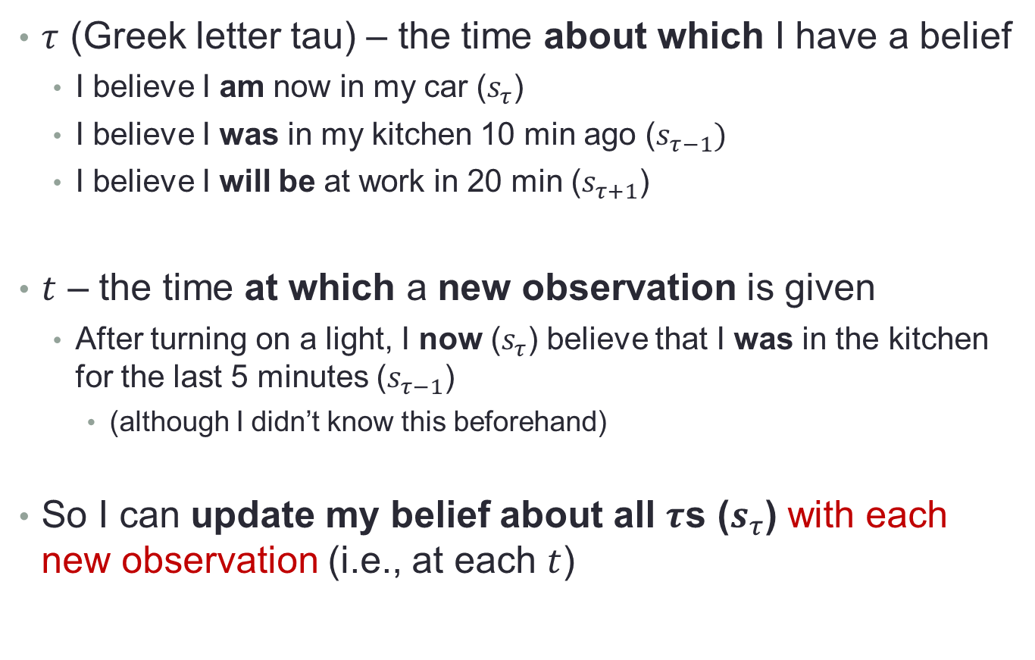
Dynamic perception: Hidden Markov model
$τ$ (Greek letter tau) – the time about which I have a belief
I believe I am now in my car ($s_{τ}$)
I believe I was in my kitchen 10 min ago ($s_{τ−1})$
I believe I will be at work in 20 min ($s_{τ+1}$)
$t$ – the time at which a new observation is given
After turning on a light, I now ($s_{τ}$) believe that I was in the kitchen for the last 5 minutes ($s_{τ−1}$)
(although I didn’t know this beforehand)
So I can update my belief about all $τ$s ($s_{τ}$) with each new observation (i.e., at each $t$)

Slide 14
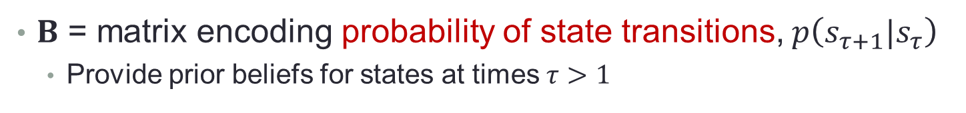
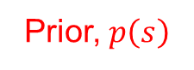
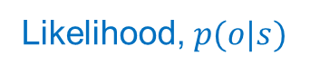
Dynamic perception: Hidden Markov model
$B$ = matrix encoding probability of state transitions, $p\left(s_{τ+1}|s_{τ}\right)$
Provide prior beliefs for states at times $τ>1$
Prior, $p\left(s\right)$
Likelihood, $p(o|s)$
† indicates a transpose and then normalizing columns

Slide 15
Dynamic perception: Hidden Markov model
$B$ = matrix encoding probability of state transitions, $p\left(s_{τ+1}|s_{τ}\right)$
Provide prior beliefs for states at times $τ>1$
Prior, $p\left(s\right)$
Likelihood, $p(o|s)$
† indicates a transpose and then normalizing columns

Slide 16
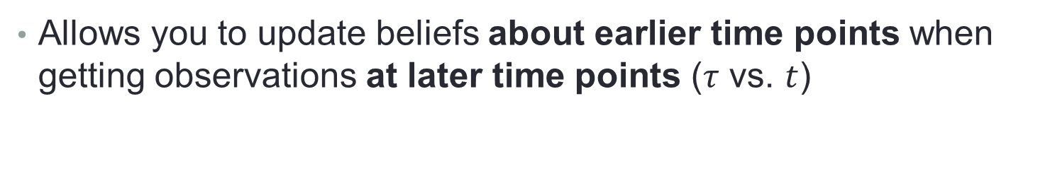
Dynamic perception: Hidden Markov model
Allows you to update beliefs about earlier time points when getting observations at later time points ($τ$ vs. $t$)
Prior from the future
† indicates a transpose and then normalizing columns

Slide 17
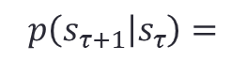
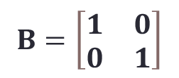
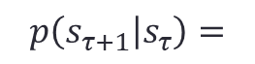
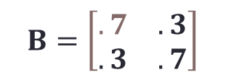
Dynamic perception
$$p\left(s_{τ+1} | s_{τ}\right)=$$
L R
$$B=\left[\begin{matrix}.7 & .3 \\ .3 & .7\end{matrix}\right]$$
L
R
$$p\left(s_{τ+1} | s_{τ}\right)=$$
L R
$$B=\left[\begin{matrix}1 & 0 \\ 0 & 1\end{matrix}\right]$$
L
R
If the left machine is better at time point 1
it will still be better at time point 2
with probability = .7
If the left machine is better at time point 1
it will still be better at time point 2
with probability = 1

Slide 18
Decision-making
Policies:
possible sequences of actions
For example:
Take hint and then choose left machine
Immediately choose left
…
Transitioning from the “start” state to the “take the hint” state
Each policy entails a different sequence of state transitions
Transitioning from the “start” state to the “choose left machine” state

Slide 19
Infer states for each policy in parallel
Policy 1
1
2
Policy 2
1
3

Slide 20
Preferred observations (reward)
Policies with the lowest expected free energy will be those expected to:
generate preferred outcomes
maximize information gain
Expected free energy:
How good is each policy?

Slide 21
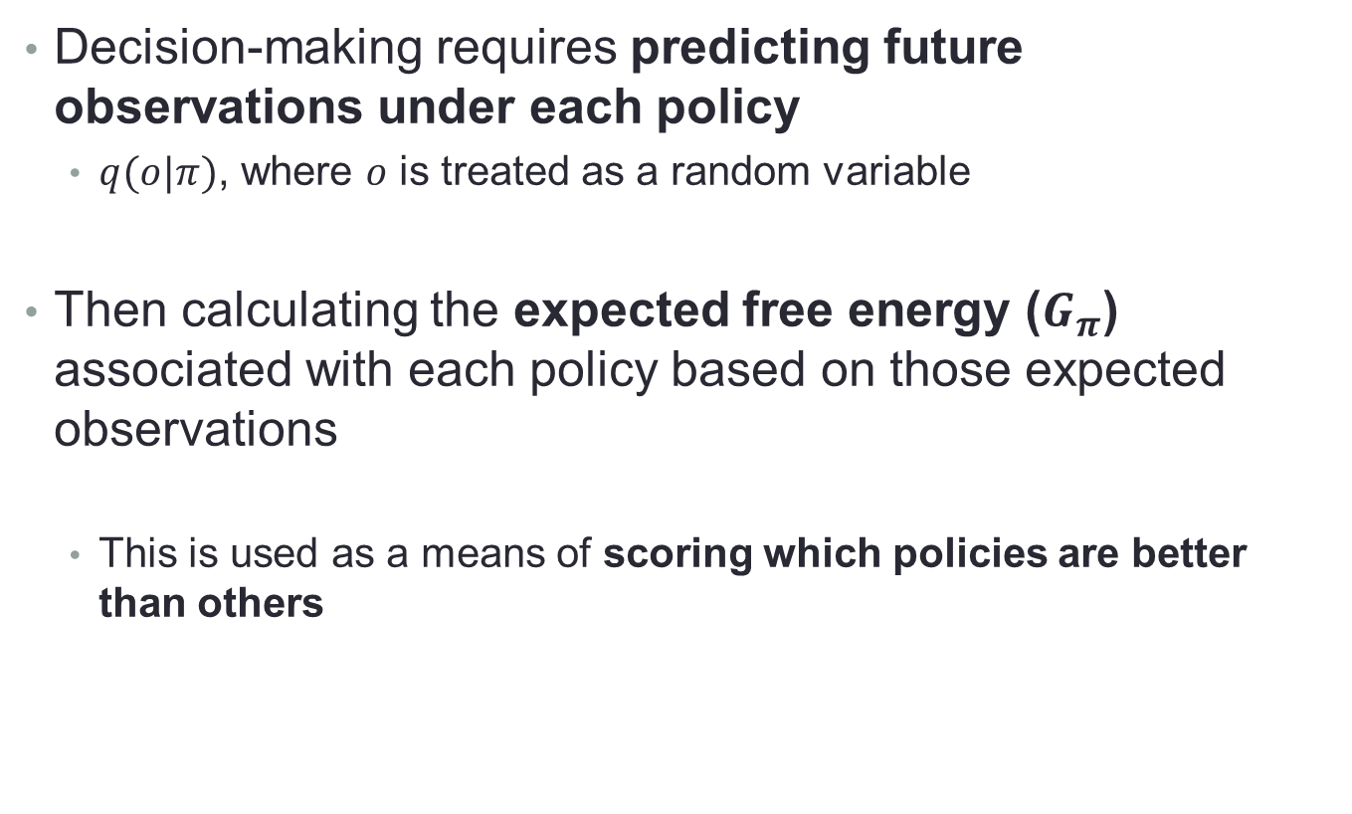
Expected free energy
Decision-making requires predicting future observations under each policy
$q(o|π)$, where $o$ is treated as a random variable
Then calculating the expected free energy ($G_{π}$) associated with each policy based on those expected observations
This is used as a means of scoring which policies are better than others

Slide 22
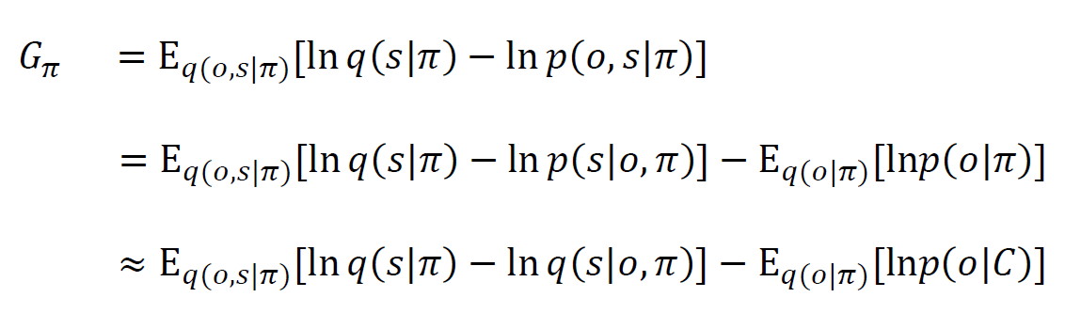
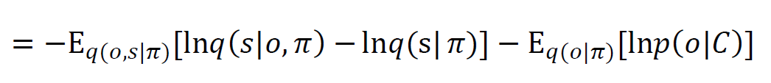
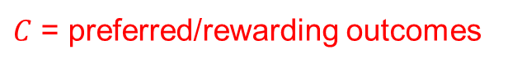
Expected free energy
$C$ = preferred/rewarding outcomes
The literature shows many different decompositions:
“Epistemic value”
“Pragmatic value”
–
“How much do I expect beliefs about states will change after a new observation if I choose this policy?”
Expected probability of preferred outcomes
“Novelty” (if learning the likelihood)
“How much do I expect beliefs ABOUT THE LIKELIHOOD – A = p(o|s) – will change after a new observation if I choose this policy?”

Slide 23
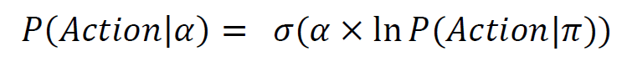
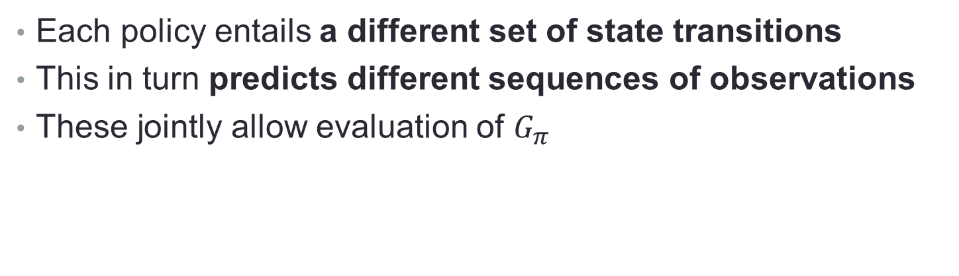
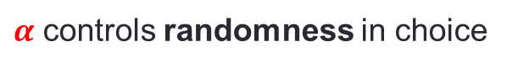
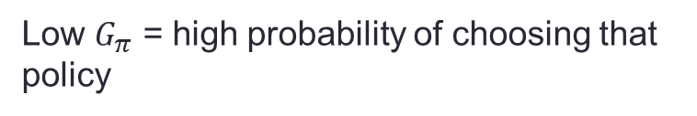
Graphical model of POMDP structure
Each policy entails a different set of state transitions
This in turn predicts different sequences of observations
These jointly allow evaluation of $G_{π}$
Low $G_{π}$ = high probability of choosing that policy
$α$ controls randomness in choice

Slide 24
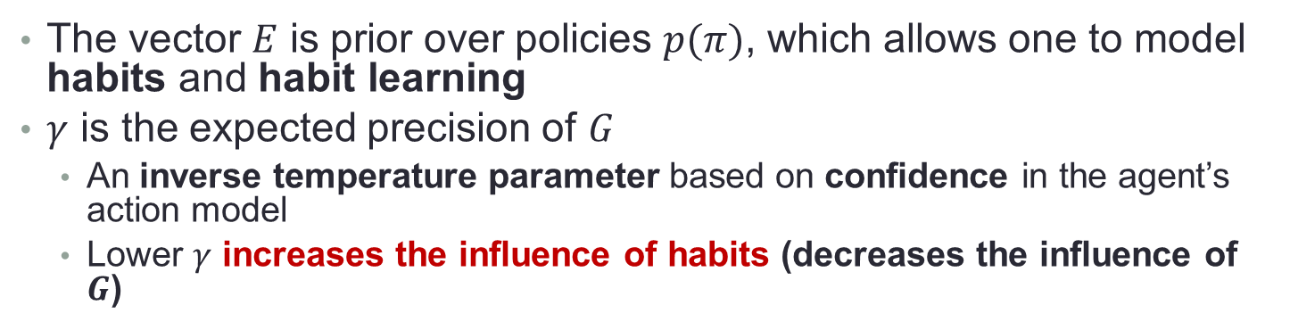
Graphical model of POMDP structure
The vector $E$ is prior over policies $p(π)$, which allows one to model habits and habit learning
$γ$ is the expected precision of $G$
An inverse temperature parameter based on confidence in the agent’s action model
Lower $γ$ increases the influence of habits (decreases the influence of $G$)

Slide 25
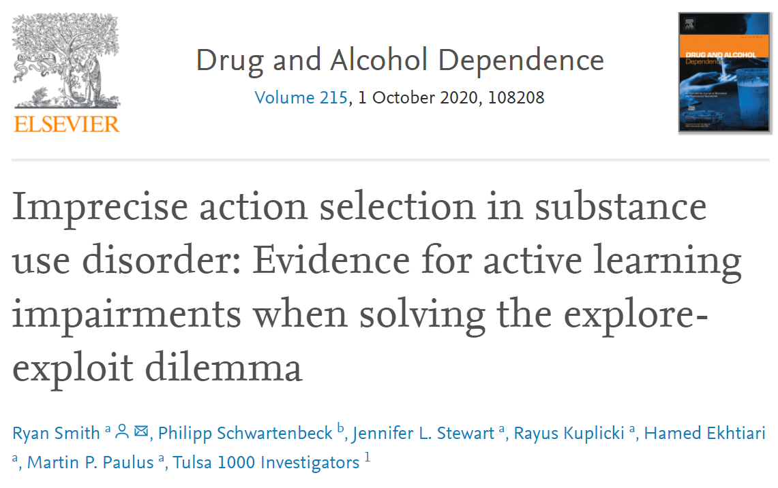
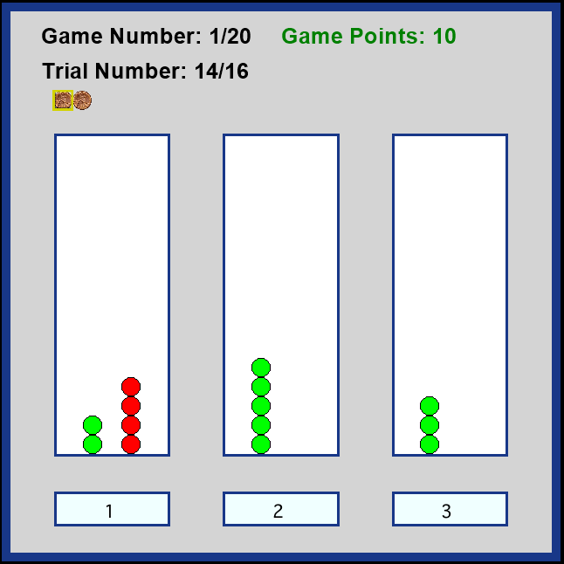
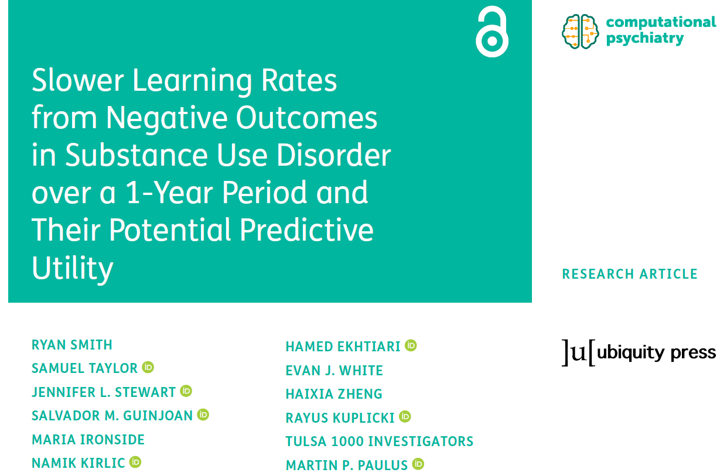
Three-armed bandit task
Three “slot machines” with unknown reward probabilities

Slide 26
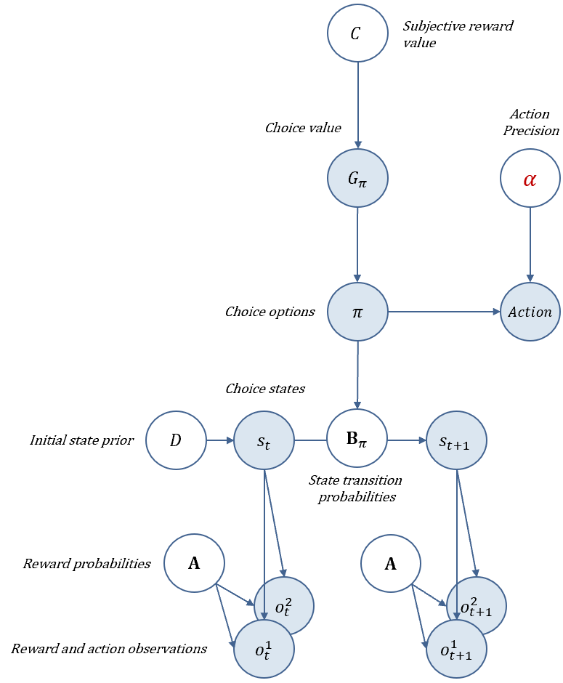
Three-armed bandit task model
Three “slot machines” with unknown reward probabilities

Slide 27
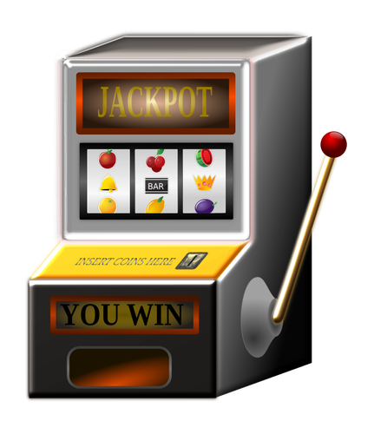
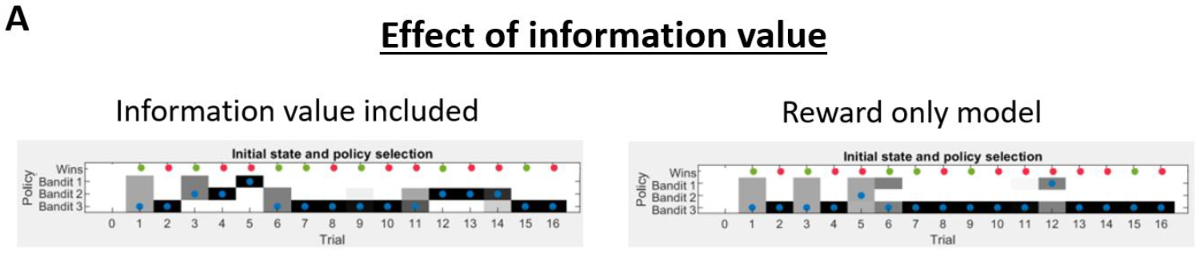
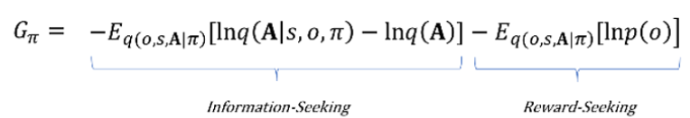
Active Learning
1
2
3
Three slot machines with unknown reward probabilities

Slide 28
Active Learning
1
2
3
Three slot machines with unknown reward probabilities

Slide 29
Active Learning
1
2
3
Three slot machines with unknown reward probabilities

Slide 30
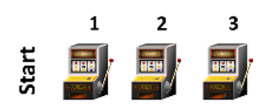
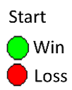
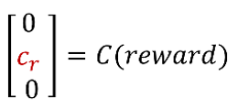
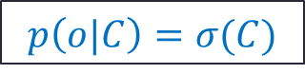
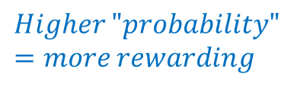

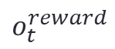






Learning Reward probabilities
$$σ\left(∙\right)=softmax$$
$$Larger=more rewarding$$
$$s_{t}^{choice}=$$
$$A=p\left(o_{t}^{reward} | s_{t}^{choice}\right)= \left[\begin{matrix}1 & 0 & 0 & 0 \\ 0 & r_{1} & r_{2} & r_{3} \\ 0 & {1−r}_{1} & 1−r_{2} & 1−r_{3}\end{matrix}\right]$$
$$p\left(A\right)=Dirichlet(a)$$
$$o_{t}^{reward}$$
$$p\left(o|C\right)=σ(C)$$
$$a = \left[\begin{matrix}1 & 0 & 0 & 0 \\ 0 & a_{1} & a_{2} & a_{3} \\ 0 & a_{4} & a_{5} & a_{6}\end{matrix}\right]$$
$$Higher "probability"=more rewarding$$
$$a=\text{"}\text{concentration} \text{parameters}\text{"}$$
Count how many times you won/lost after each choice

Slide 31


Learning Reward probabilities
$$σ\left(∙\right)=softmax$$
$$Larger=more rewarding$$
$$s_{t}^{choice}=$$
$$A=p\left(o_{t}^{reward} | s_{t}^{choice}\right)= \left[\begin{matrix}1 & 0 & 0 & 0 \\ 0 & r_{1} & r_{2} & r_{3} \\ 0 & {1−r}_{1} & 1−r_{2} & 1−r_{3}\end{matrix}\right]$$
$$p\left(A\right)=Dirichlet(a)$$
“Counts”
$$p\left(o|C\right)=σ(C)$$
$$o_{t}^{reward}$$
$$a = \left[\begin{matrix}1 & 0 & 0 & 0 \\ 0 & 10 & 2 & 3 \\ 0 & 10 & 2 & 1\end{matrix}\right]$$
$$Higher "probability"=more rewarding$$
$$p\left(o_{reward} | s_{choice}\right)=σ\left(a\right)=\left[\begin{matrix}1 & 0 & 0 & 0 \\ 0 & .5 & .5 & .75 \\ 0 & .5 & .5 & .25\end{matrix}\right]$$
$$a=\text{"}\text{concentration} \text{parameters}\text{"}$$
Count how many times you won/lost after each choice

Slide 32





Learning Reward probabilities
$η$ = .5
$$a =p\left(o_{reward} | s_{choice}\right)=$$
$η$ = 1
Reward probability
Choose #2 and observe a win
.2 1.2 .2
.2 .2 .2
.2 .7 .2
.2 .2 .2
5 5 5
5 5 5
5 5.5 5
5 5 5
.2 .2 .2
.2 .2 .2
$$a_{trial}=(1−omega) x a_{trial−1}+ η×\sum_{τ}{o_{t} ⊗ s_{t}}$$
$$Learning Rate$$

Slide 33




Policies ($π$): Which state do I transition to?
$$π^{3}$$
Based on both expected reward and expected information gain
(i.e., confidence in the reward probabilities)
$$π^{2}$$
$$π^{1}$$
Reward probability
Choose #2 and observe a win
5 5.5 5
5 5 5
.2 1.2 .2
.2 .2 .2
.2 .7 .2
.2 .2 .2
5 5 5
5 5 5
5 5.5 5
5 5 5
.2 .2 .2
.2 .2 .2

Slide 34
Policies ($π$): Which state do I transition to?
$$π^{3}$$
Based on both expected reward and expected information gain
(i.e., confidence in the reward probabilities)
$$π^{2}$$
$$π^{1}$$
Reward probability
Choose #2 and observe a win
5 5.5 5
5 5 5
.2 1.2 .2
.2 .2 .2
.2 .7 .2
.2 .2 .2
.2 .2 .2
.2 .2 .2

Slide 35






$$σ\left(∙\right)=softmax$$
$α=action precision$ (higher = less random)
$$c_{r}=reward sensitivity$$
(higher = greater reward-seeking drive)
$$a_{0}=information sensitivity$$
(higher = quicker switch to exploitation)
$$η=learning rate$$
(can be separated for wins and losses)
$$G_{π}=$$
$$\left.−Ε_{\left.q(o,s,A|π\right)}[lnq\left(A | s,o,π\right)−lnq\left(A\right)]−Ε_{\left.q(o,s,A|π\right)}[lnp\left(o|C\right)\right]$$

Slide 36
Move to code (TAB_example.m)

Slide 37
Parameter value estimates for each participant
Can address interesting questions in empirical studies:
Individuals with substance use disorders show
Three-armed bandit task

Slide 38

Parameter value estimates for each participant
Can address interesting questions in empirical studies:
Individuals with substance use disorders show
lower action precision
slower learning rate from losses
Three-armed bandit task

Slide 39

Parameter value estimates for each participant
Parameter values at baseline were also associated with changes in substance use severity over the following year

Slide 40
Steps for empirical modelling
Select and run parameter estimation algorithm for each model being considered
Perform Bayesian model comparison to confirm the best model.
Model checking: Generate simulated behavior in the best model, and then estimate parameters using this simulated behavior.
Confirm that estimates approach the parameter values used to generate the simulated behavior.
Confirm that generative and estimated parameter values are strongly correlated.
Run regression or group comparison analyses on parameters at the between-subjects level.

Slide 41


Select and run parameter estimation algorithm
Several approaches with varying levels of complexity
Simplest is a grid search
Only works in simple models with a small number of parameters
$$p\left(data\right|model)$$
8
Parameter 2
(e.g., preference precision)
Best fit
0
0
1
Parameter 1 (e.g., learning rate)

Slide 42
Move to code (fit_demo.m)

Slide 43
Select and run parameter estimation algorithm
Several approaches with varying levels of complexity
For this example, we will use one leading approach called Variational Bayes
Works well for complex models with larger numbers of parameters
This uses iterative updating to find parameter values that minimize variational free energy
Same thing that active inference models do to accomplish state inference
You start by specifying some initial estimation priors for each parameter with a mean and a variance
Estimation moves from those priors to posteriors over parameters
Maximizes accuracy while minimizing movement from prior values
Smaller prior variance deters overfitting

Slide 44

$$p\left(data\right|model)$$
8
Prior value
Several approaches with varying levels of complexity
For this example, we will use one leading approach called Variational Bayes
Works well for complex models with larger numbers of parameters
This uses iterative updating to find parameter values that minimize variational free energy
Same thing that active inference models do to accomplish state estimation!
You start by specifying some initial estimation priors for each parameter with a mean and a variance
Estimation moves from those priors to posteriors over parameters
Maximizes accuracy while minimizing movement from prior values
Smaller prior variance deters overfitting
Posterior Value
Parameter 2
(e.g., preference precision)
0
0
1
Parameter 1 (e.g., learning rate)

Slide 45
$$p\left(data\right|model)$$
8
Several approaches with varying levels of complexity
For this example, we will use one leading approach called Variational Bayes
Works well for complex models with larger numbers of parameters
This uses iterative updating to find parameter values that
You might try multiple starting priors to make sure they give you similar (correlated) posterior estimates
Parameter 2
(e.g., preference precision)
Posterior Value
Prior value
0
0
1
Parameter 1 (e.g., learning rate)

Slide 46
Select and run parameter estimation algorithm
Check to make sure convergence is smooth

Slide 47
Move to code (TAB_demo_main.m)

Slide 48

Bayesian Model Comparison
Create several different task models
Can be same model structure but including/removing different parameters
Compare the free energies of each fitted model for each participant
Model with the lowest free energy across participants is the one that best explains the data

Slide 49
Bayesian Model Comparison
Create several different task models
Can be same model structure but including/removing different parameters
Compare the free energies of each fitted model for each participant
Model with the lowest free energy across participants is the one that best explains the data
spm_BMS.m function
Move to code (TAB_demo_main.m)

Slide 50
Model checking
You need to make sure that the parameter estimates in your winning model are reliable
One way to do that is to generate simulated data using different parameters
then try to estimate parameters from the simulated data
If the estimated parameters are similar to the true parameters you used to generate the simulated behavior
then this supports reliability
Similar considerations with model identifiability
If they’re not similar, this suggests multiple parameter combinations that could explain data equally well
E.g., high learning rate and low action precision or low learning rate and high action precision might produce the same behavior in simulations
In this case, parameter estimates may not provide a uniquely best explanation for the data

Slide 51

Model checking
If they’re not similar, this suggests there may be multiple parameter combinations that could explain data equally well
Equally good
If a grid search were possible
Action precision
Learning rate

Slide 52
Model identifiability
Generate simulated data from models with different numbers of parameters
Data from a model with only action precision and reward sensitivity (with all other parameters at fixed values)
Data from a model that also includes learning rate
Fit each set of data to each model
Check if model comparison identifies the right model

Slide 53

Model identifiability

Slide 54
Steps to determine parameter estimate reliability

Slide 55

Group-level analyses
You could simply take the posterior parameter mean estimates and use them as predictors or outcome variables.
For example, is learning rate faster in those with higher anxiety?
Is depression associated with lower information-seeking?
However, variational Bayes also gives you posterior variances (confidence around mean estimates)
Some approaches allow you to incorporate that information
For example, by down-weighting estimates with high posterior variance

Slide 56
Parametric Empirical Bayes (PEB)
PEB uses a general linear model and does Bayesian model comparison between models with and without relationships between predictors and each parameter
While incorporating posterior parameter variances
Retains the reduced model (removing one or more predictors) with the most evidence
Or a full model could win

Slide 57
Select and run parameter estimation algorithm

Slide 58
Select and run parameter estimation algorithm

Slide 59
Steps for empirical modelling using this example approach
Select estimation priors, including prior means and variances.
Run variational Bayes on participant data for each model under consideration.
Check that iterative updating (gradient descent) shows smooth convergence toward a free energy minimum.
Perform Bayesian model comparison to confirm the best model.
Generate simulated behavior in the best model using the parameter values estimated in your participants, and then run variational Bayes to estimate parameters using this simulated behavior.
Confirm that posterior estimates approach the parameter values used to generate the simulated behavior.
Confirm that posterior co-variances are not high.
Confirm that generative and estimated parameter values are strongly correlated.
Use PEB to run regression or group comparison analyses on posterior means and variances at the between-subjects level.

Slide 60

More detailed walkthrough of foundational background information:
https://medicine.yale.edu/psychiatry/education/map/support/ryan/
(Video is at the very bottom of the page)

